Slide 1
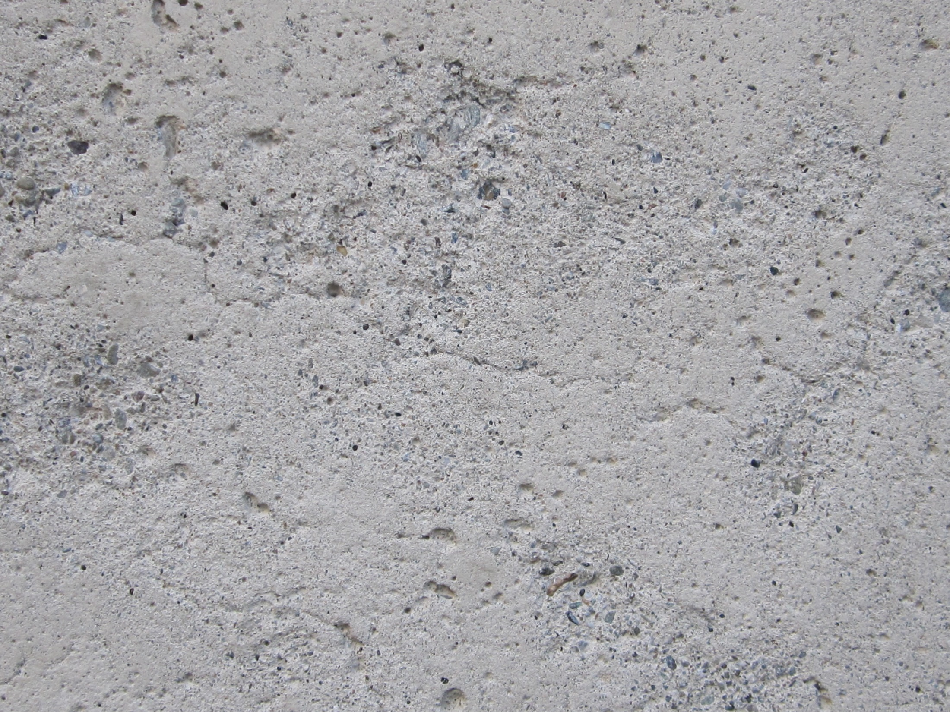

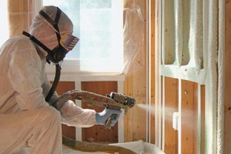

PARTNERS
tour
about
a special thank you to our
PARNTERS
insulation
… and more to come.

